Slide 1
Implicit Neuronal Representation (INR) : Applied to PET and CT in Reconstruction and denoising tasks
Students : Mauricio Salim GÓMEZ CHICRE
Áureo Henrique E SILVA MARQUES
Tutors : Younès MOUSSAOUI
Diana MATEUS

Slide 2
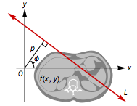
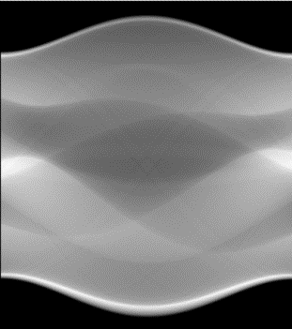
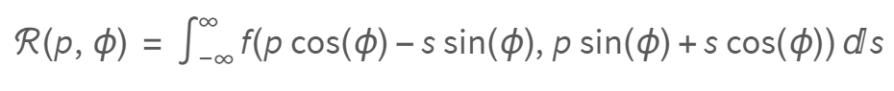
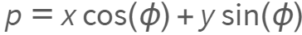
Context
Computed tomography (CT) is a medical imaging technique that uses X-rays to produce detailed cross-sectional images of the body.
Radon Transform
Where :
https://www.wolframcloud.com/obj/exploration/RadonTransformAndCTScans.nb

Slide 3
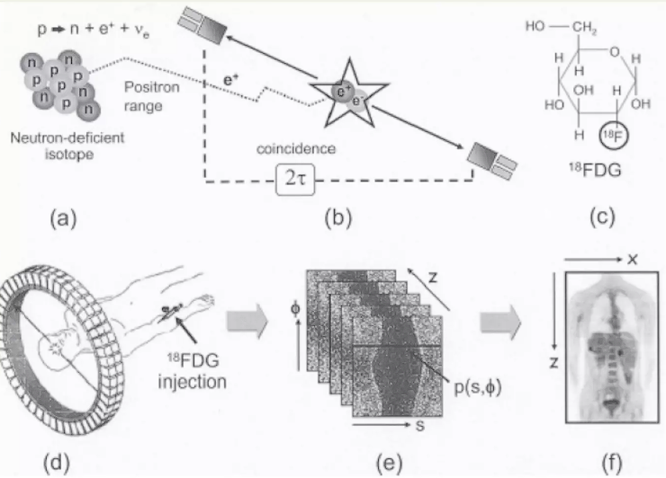
Context
Positron emission tomography (PET) is a nuclear imaging modality that measures the metabolic activity of cells in body tissues.
However, the radionuclides inserted are harmful to the body, which means that the quantity applied has to be reduced as well as the scan time as to not analyze every angle, thus reducing image quality.
Figure 1. (a) and (b) examples of a radionuclide reacting with an electron and releasing photons. (c) a radionuclide used in brain scans. (d), (e) and (f) PET scan acquisition process.
Vibha CHASWAL. Causes of Noise in PET imaging. URL :https://es.slideshare.net/slideshow/causes-of-noise-in-pet-imaging/12868791
Notes:
CT and PET : Widely used as they provide vital information for diagnostics.

Slide 4
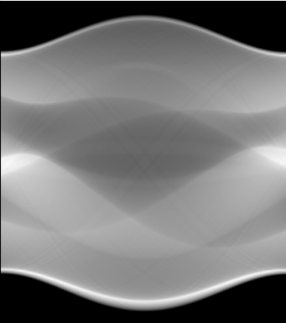
Context
As mentioned, PET and CT scans provide a sinogram, and not the image of the organ directly, a reconstruction is need.
Traditionally done through mathematical models and iterative algorithms, involving the minimization of an error criterion between the input sinogram and the estimated image by the model, or the maximization of a likelihood of the latter two.
The interest in Deep Learning (DL) reconstruction over traditional comes from its potential to maintentain image quality, while reducing the dose and time required in scans.

Slide 5
Context
This is where we draw our attention towards Implicit Neural Representation, as they have proved to have several advantages over traditional methods in reconstruction and denoising tasks in CT:
Efficient memory usage.
Reduction of labeled data dependency.
Enables detailed 3D anatomical structure reconstruction or 2D scan generation.
Effective for super-resolution.
Independence of resolution.

Slide 6
Objectives:
Investigate INRs in the context of PET and CT imaging.
Adapt INRs for PET and CT Reconstruction and Denoising tasks.
Compare INRs performance with traditional Reconstruction and Denoising methods.

Slide 7
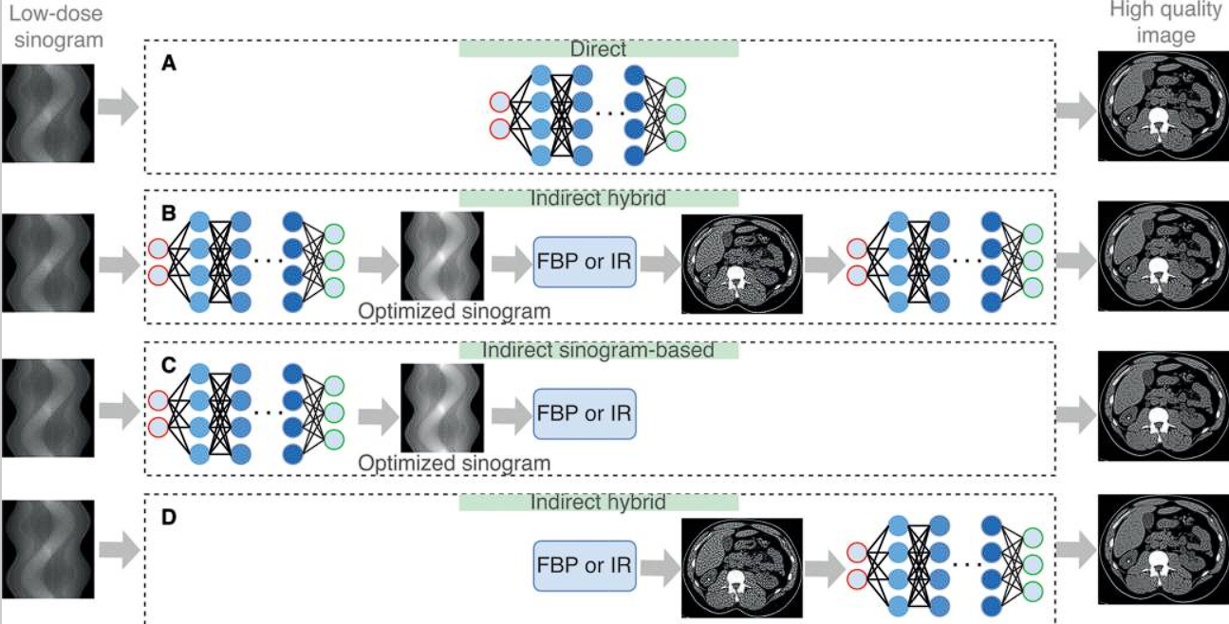
Image Reconstruction and Denoising Timeline :
2017
Deep Learning Framework
Figure 2. Diagram shows overview of different deep learning reconstruction (DLR) types.
Koetzier LR, Mastrodicasa D, Szczykutowicz TP, van der Werf NR, Wang AS, Sandfort V, van der Molen AJ, Fleischmann D, Willemink MJ. Deep Learning Image Reconstruction for CT: Technical Principles and Clinical Prospects. Radiology. 2023 Mar;306(3):e221257. doi: 10.1148/radiol.221257.

Slide 8
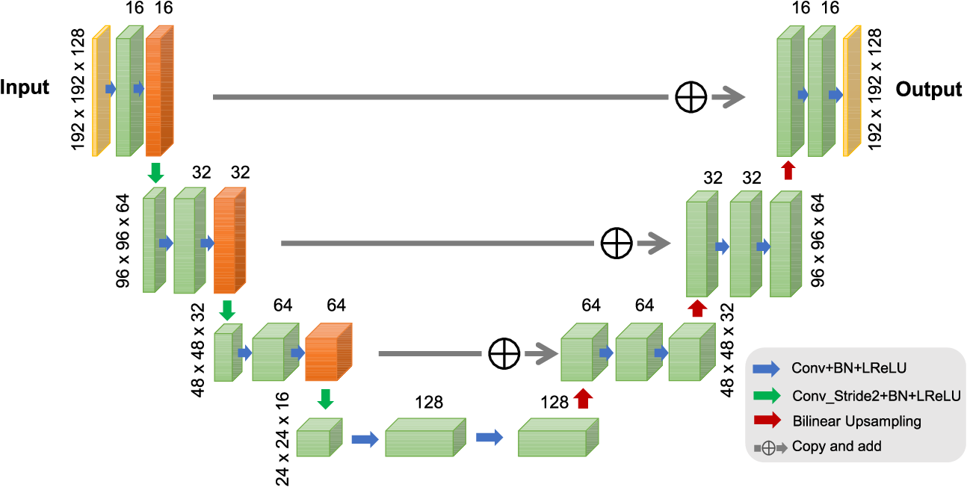
Image Reconstruction and Denoising Timeline :
2017
Deep Learning Framework
Figure 3. PET Image Reconstruction Using Deep Image Prior.
K. Gong, C. Catana, J. Qi and Q. Li, "PET Image Reconstruction Using Deep Image Prior," in IEEE Transactions on Medical Imaging, vol. 38, no. 7, pp. 1655-1665, July 2019, doi: 10.1109/TMI.2018.2888491.

Slide 9
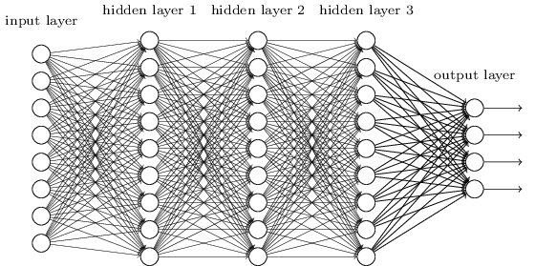
Image Reconstruction and Denoising Timeline :
2017
2020
Deep Learning Framework
- NeRF
- SIREN for CT

Slide 10
Image Reconstruction and Denoising Timeline :
2017
2020
2021
Deep Learning Framework
- NeRF
- SIREN for CT
- NeRP for CT
Notes:
NeRP no need of extra slide

Slide 11
Image Reconstruction and Denoising Timeline :
2017
2020
2021
2022
Deep Learning Framework
- NeRF
- SIREN for CT
- NeRP for CT
- TITAN for CT

Slide 12
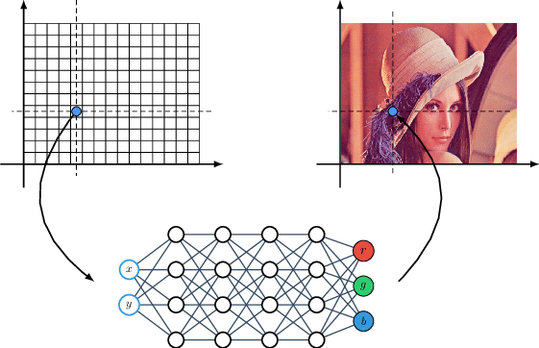
How Implicit Neural Representations work?
Implicit Neural Representations parameterize a signal as a continuous function that maps the domain of the signal to whatever is at that coordinate (color, depth, texture, etc).
These functions are not analytically controllable - it is impossible to "write down" the function that parametrizes a natural image as a mathematical formula.
Implicit Neural Representations thus approximate that function via a neural network.
Figure 4. An illustration of an image represented in the implicit neural representation (INR) form, i.e. as an MLP that predicts an RGB pixel value given its (x, y) coordinates.
https://www.researchgate.net/figure/An-illustration-of-an-image-represented-in-the-implicit-neural-representation-INR-form_fig1_346302971
https://github.com/vsitzmann/awesome-implicit-representations?tab=readme-ov-file#what-are-implicit-neural-representations
Notes:
(i.e., a coordinate, such as a pixel coordinate for an image towards the R,G,B color of that pixel)

Slide 13
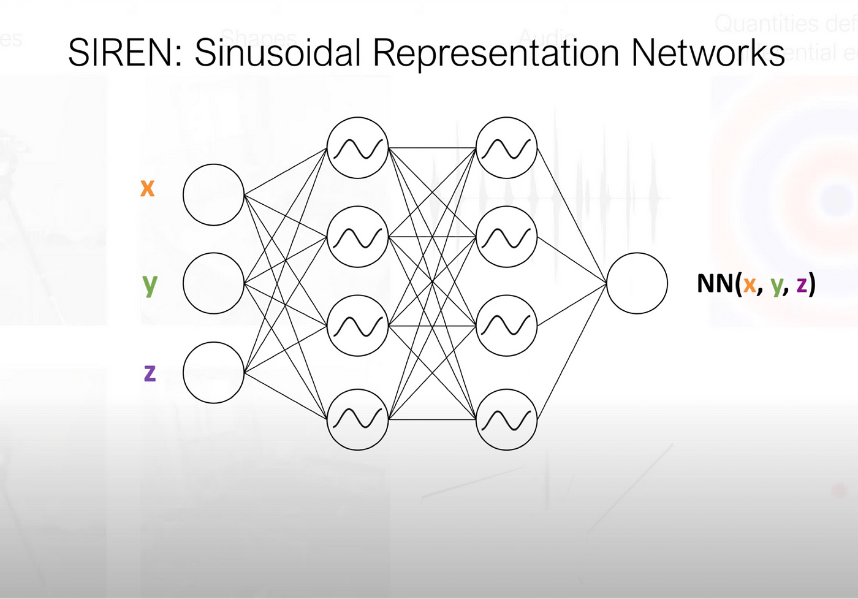
SIREN
Sinusoidal Representation Networks
Figure 5. Representation of a Sinusoidal Representation Network [1]
[2]
Where : is the initialization hyperparameter used in the activation function of the first layer.
[1] https://medium.com/@aryamansriram/paper-review-implicit-neural-representations-with-periodic-activation-functions-c1e00179cb8e
[2] Vincent SITZMANN et al. « Implicit neural representations with periodic activation functions ». In : (2020).

Slide 14
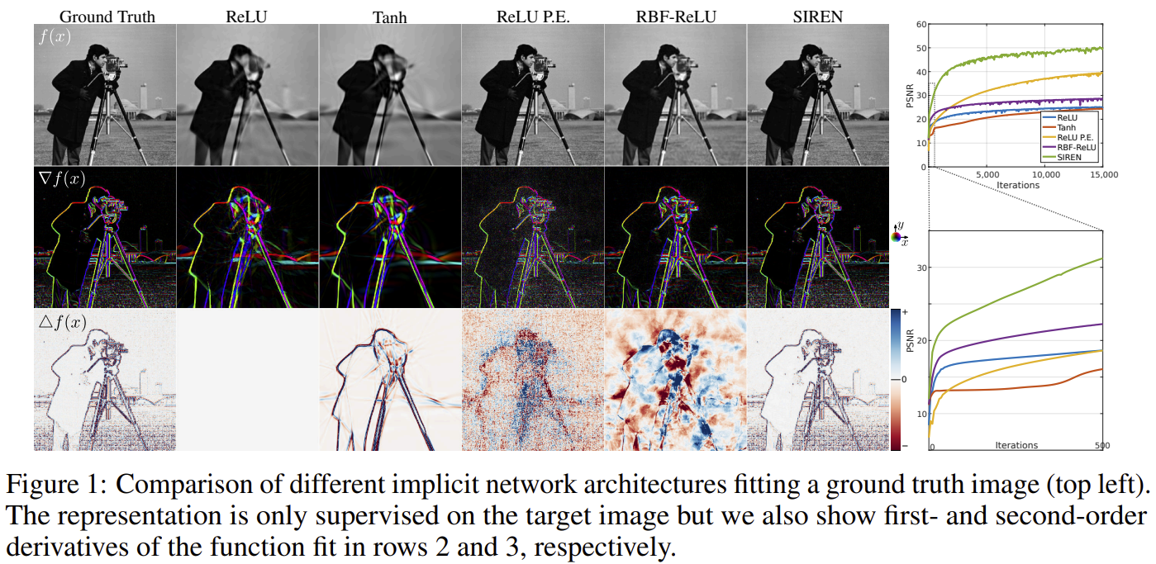
SIREN
Sinusoidal Representation Networks
6
Vincent SITZMANN et al. « Implicit neural representations with periodic activation functions ». In : (2020).

Slide 15
Applications in CT and PET
Denoising
Input: Noised Image Output: Denoised Image Traditional Methods: Filters and Deep Learning Our Method: SIREN Network
Reconstruction
Input: Sinogram Output: Reconstructed Image Traditional Methods: CT: Filtered Back Projection (FBP) PET: Maximum-Likelihood Expectation-Maximization (MLEM) Our Method: SIREN Network + Forward Projection

Slide 16

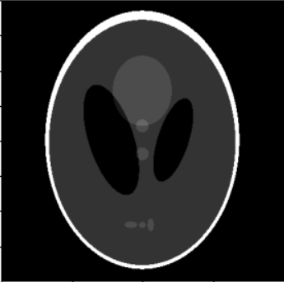
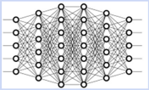
Applications in CT and PET:
Denoising
Y
SIREN
X
Model output
(Denoised Image)
Model input
(Image Coordinates)
Loss = MSE( Denoised Image, Noised Image)

Slide 17
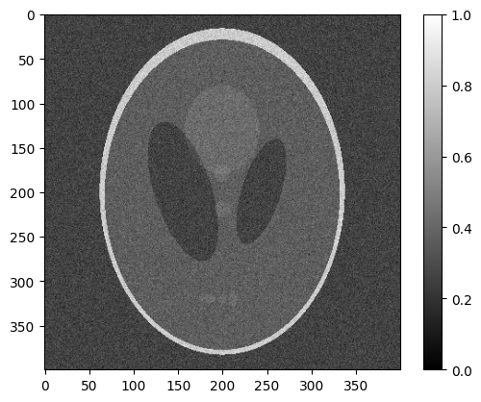
Applications in CT and PET:
Denoising
Sample Data (CT)
Shepp-Logan Phantom
Noisy Image - PSNR 12.68
(Gaussian Noise, std = 0.1)

Slide 18
Applications in CT and PET:
Denoising
ω₀ | Best MSE | Best PSNR | Best MSSIM
10 | 0,0472 | 22,0477 | 0,4704
15 | 0,0437 | 23,3199 | 0,4825
20 | 0,0447 | 22,8385 | 0,4850
25 | 0,0455 | 22,5383 | 0,4727
30 | 0,0455 | 22,7231 | 0,4752
35 | 0,0454 | 21,6254 | 0,4543
40 | 0,0456 | 21,5055 | 0,4526
45 | 0,0459 | 21,1779 | 0,4467
50 | 0,0458 | 20,6162 | 0,4371
Optimizer: Adam; LR: 10⁻⁴; Steps: 3000
Time ≈ 5 min

Slide 19
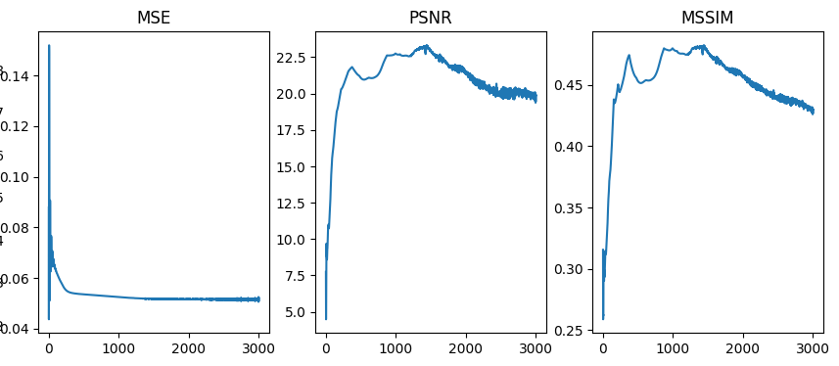
Applications in CT and PET:
Denoising
ω₀ = 15

Slide 20
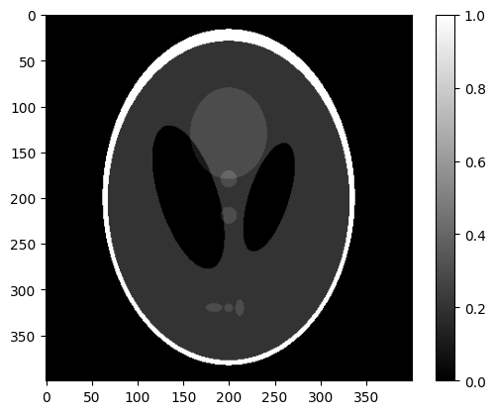
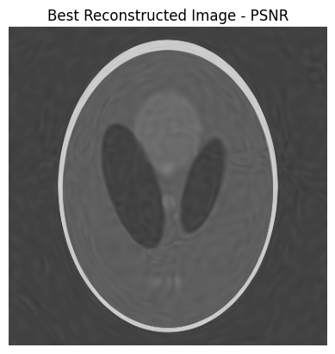
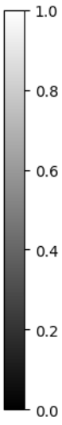
Applications in CT and PET:
Denoising
Best PSNR: 23,32
ω₀ = 15
Ground Truth Image
Noisy Image
Denoised Image

Slide 21

Applications in CT and PET:
Denoising
Best MSSIM: 0.485
ω₀ = 20
Ground Truth Image
Noisy Image
Denoised Image

Slide 22
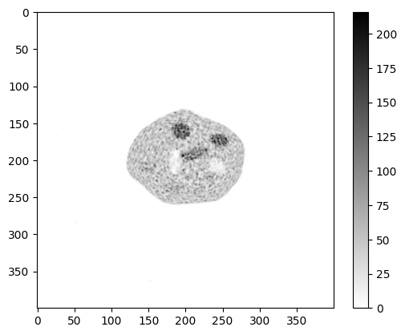
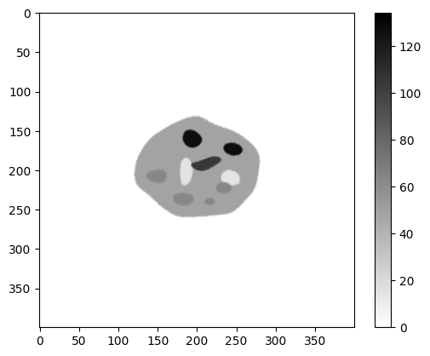
Applications in CT and PET:
Denoising
Sample Data (PET)
PET Phantom
Noisy Image - PSNR 25.10
(BSREM reconstruction, low regularization)

Slide 23
Applications in CT and PET:
Denoising
ω₀ | Best MSE | Best PSNR | Best MSSIM
10 | 0,0026 | 30,7600 | 0,48265
15 | 0,0026 | 31,54091 | 0,4942
20 | 0,0026 | 30,5561 | 0,62731
25 | 0,0026 | 31,9899 | 0,69922
30 | 0,0026 | 31,0513 | 0,79962
35 | 0,0026 | 30,9182 | 0,80833
40 | 0,0026 | 30,4557 | 0,81596
45 | 0,0027 | 30,32822 | 0,84397
50 | 0,0027 | 29,49719 | 0,85385
Optimizer: Adam; LR: 10⁻⁴; Steps: 3000
Time ≈ 5 min

Slide 24
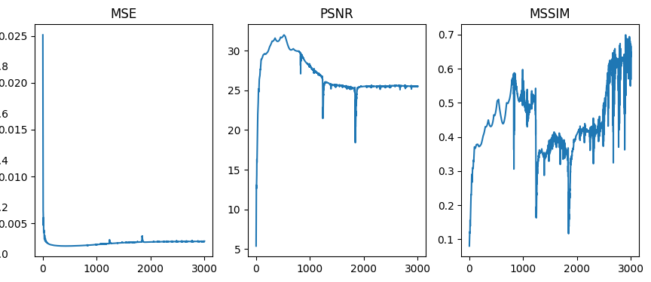
Applications in CT and PET:
Denoising
ω₀ = 25

Slide 25
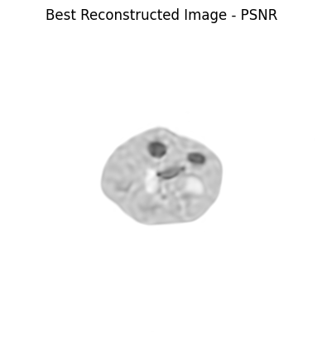
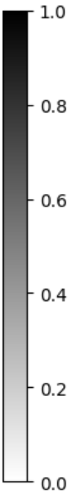
Applications in CT and PET:
Denoising
Best PSNR: 31.99
ω₀ = 25
Ground Truth Image
Noisy Image
Denoised Image

Slide 26
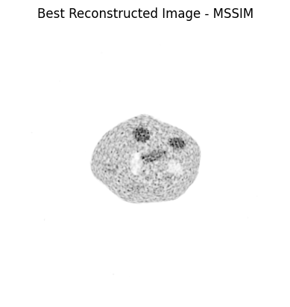
Applications in CT and PET:
Denoising
Best MSSIM: 0.854
ω₀ = 50
Ground Truth Image
Noisy Image
Denoised Image

Slide 27
Applications in CT and PET:
Reconstruction
Y
SIREN
X
Model output
(Reconstructed CT Image)
Model input
(CT Image Coordinates)
Radon Transform
Loss =
MSE(Generated Sinogram , Original Sinogram)
Generated Sinogram

Slide 28
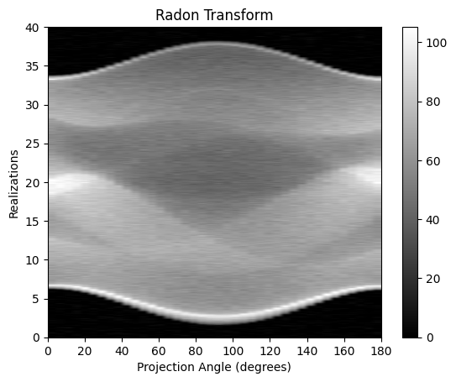
Applications in CT and PET:
Reconstruction
Sample Data (CT)
Shepp-Logan Phantom
Noisy Sinogram
(Gaussian Noise, std = 2)

Slide 29
Applications in CT and PET:
Reconstruction
Angles | Best MSE | Best PSNR | Best MSSIM
100 | 0,0017 | 27,2866 | 0,9024
80 | 0,0018 | 27,4443 | 0,8991
60 | 0,0021 | 26,7677 | 0,8972
40 | 0,0033 | 24,8172 | 0,8440
Optimizer: Adam; LR: 10⁻⁴; Steps: 6000; ω₀: 40
Time ≈ 25 min

Slide 30
Applications in CT and PET:
Reconstruction
However, when we double the number of steps, it reaches a PSNR of 27,55
ω₀ | Best MSE | Best PSNR | Best MSSIM
10 | 0,0022 | 26,5460 | 0,9231
20 | 0,0018 | 27,0504 | 0,9023
30 | 0,0021 | 26,8212 | 0,8977
40 | 0,0033 | 24,8172 | 0,8440
50 | 0,0063 | 22,0083 | 0,7412
Optimizer: Adam; LR: 10⁻⁴; Steps: 6000; Angles: 40
Time ≈ 25 min

Slide 31
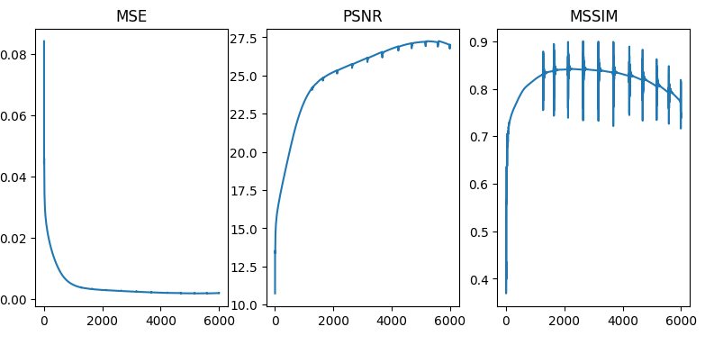
Applications in CT and PET:
Reconstruction
ω₀ = 20

Slide 32
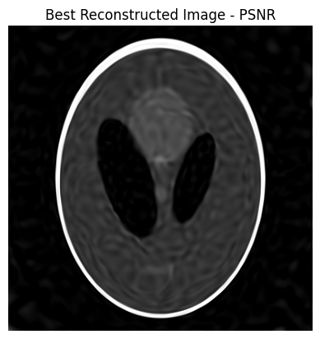
Applications in CT and PET:
Reconstruction
Best PSNR: 27,05
ω₀ = 20
Ground Truth Image
Noisy Sinogram
Reconstructed Image

Slide 33
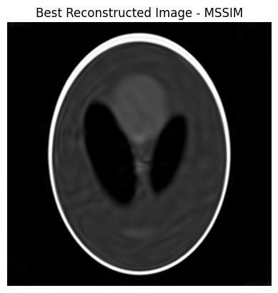
Applications in CT and PET:
Reconstruction
Best MSSIM: 0.9231
ω₀ = 10
Ground Truth Image
Noisy Sinogram
Reconstructed Image

Slide 34
Applications in PET
Reconstruction
Input: Sinogram Output: Reconstructed PET Image Traditional Model: Maximum-Likelihood Expectation-Maximization (MLEM) Our Model: SIREN Network + PET Forward Projection
Denoising
Input: Noised PET Image Output: Denoised PET Image Traditional Methods: Filters and Deep Learning Our Method: SIREN Network

Slide 35
Applications in CT and PET:
Reconstruction
Y
SIREN
X
Model output
(Reconstructed PET Image)
Model input
(PET Image Coordinates)
PET Forward Projection
Loss =
MSE(Generated Sinogram , Original Sinogram)
Generated Sinogram

Slide 36
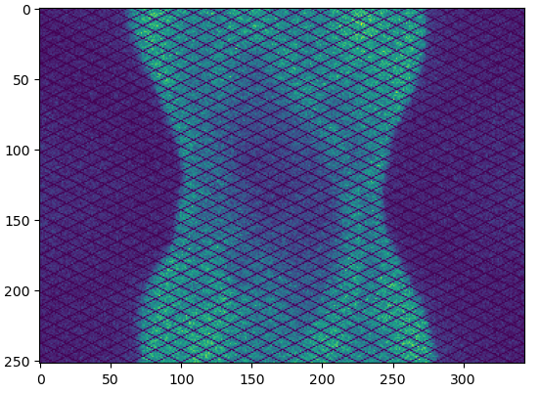
Applications in PET:
Reconstruction
Sample Data
PET Phantom
Noisy Sinogram

Slide 37
Applications in PET:
Denoising
Y
SIREN
X
Model output
(Denoised PET Image)
Model input
(PET Image Coordinates)
Loss = MSE( Denoised PET Image, Noised Image)

Slide 38
Conclusions and Perspectives
CT and PET Image Denoising:
The results for CT images were not as satisfactory, as the maximum PSNR was 23.3, also evidenced by the MSSIM not exceeding 0.5.
The method wasn’t able to clean the applied noise, it’s possible the that the cause is due to the type of noise added, other experimentations with different types of noise might help verify this.
For the PET image, we achieved better performance (PSNR 32), which is close to other experiments in PET image denoising.
The time required is significantly less than in the reconstruction task and can be further reduced by implementing early-stopping.

Slide 39
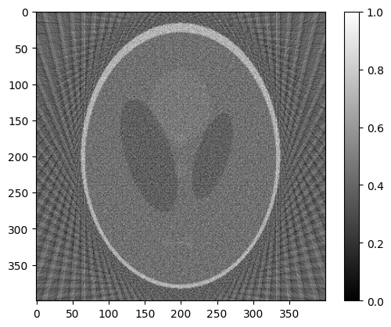
Conclusions and Perspectives
CT Image Reconstruction:
Satisfactory results achieved (PSNR 27.05), with significantly higher PSNR compared to traditional methods like FBP (PSNR 9.35).
However, the result is not immediate; it requires a significant amount of time to train the model and adjust parameters.
FBP
Our model

Slide 40
Conclusions and Perspectives
PET Image Reconstruction:
Advance in the reconstruction task: solve technical issues and analyzing performance.
Possible improvement:
Post-processing application to enhance image quality.

Slide 41
Thank you !
Students : Mauricio Salim GÓMEZ CHICRE
Áureo Henrique E SILVA MARQUES
Tutors : Younès MOUSSAOUI
Diana MATEUS

Slide 42
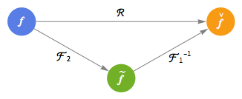
Additional Resources
https://www.wolframcloud.com/obj/exploration/RadonTransformAndCTScans.nb
Notes:
InverseRadonTransform uses the reverse of the previous procedure to recover
f from its Radon transform, as shown here.
(two-dimensional Fourier transform and the one-dimensional inverse Fourier transform)

Slide 43
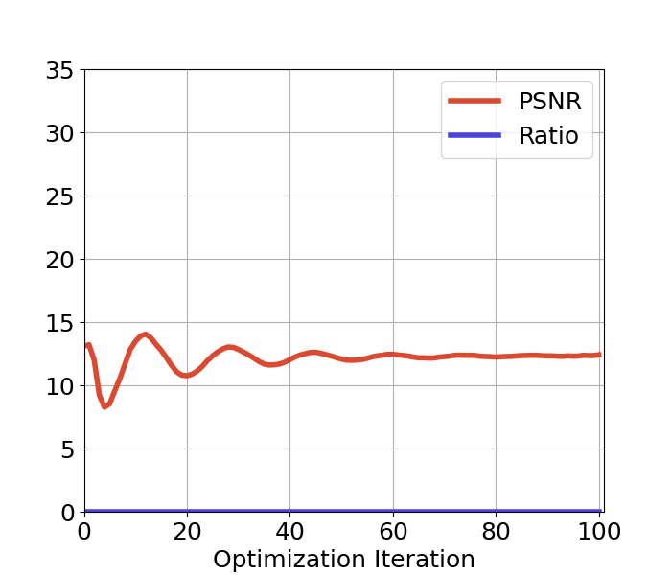

Additional Resources

